Slide 2
YOGA
AI

Slide 3
YOGA
AI
Where health is a priority!

Slide 4
Problem Statement
To build an application that aims to make use of Artificial Intelligence to create an e-yoga instructor that detects correct yoga poses and helps improve the posture.

Slide 5
Stage (1/3)
Model Training
Data Preparation
Pose Detection
Pose Classification
Yoga Pose Classification through Images

Slide 6
Stage (2/3)
Model Training
Data Preparation
Pose Detection
Pose Classification
Real-Time Pose Detection
Yoga Pose Classification through Realtime WebCam

Slide 7
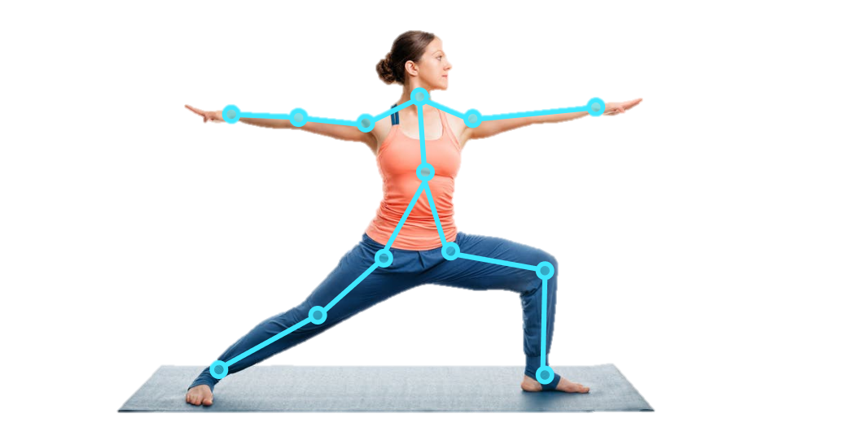
Stage (3/3)
Adding Timer for Each Pose
Web/ Mobile Application Development
Adding more poses
https://indatalabs.com/wp-content/uploads/2020/05/pose-estimation-project-t.png

Slide 8

Software and Libraries
Tensorflow
PoseNet
MoveNet
OpenCV

Slide 10
Thankyou!
Akanksha Goel
Akshita Gupta
Ayushi Sood
Rachit Mittal

